Slide 1
Capstone Project 1
Fraud Detection in Mobile Payment Data PaySim
Springboard Data Science Career Track
Eric Cruz

Slide 2
Introduction
Problem Statement
Online fraud is increasing and spreading rapidly across geographies and industries, and Mobile Payments represent a significant portion of the growth in both overall transaction and fraud rates. While attempting to detect and prevent fraud, the accuracy of the prediction models can have a significant impact on the ability to strike the right balance between true detection and false positives. The customer experience can be severely compromised by security measures enacted on the basis of a false positive. The fraud rate has a measurable impact on revenue, and new types and methods of fraud are evolving in response to successful detection and prevention efforts.
Dataset
Due to privacy concerns, there is little if any publicly available data for real transactions. PaySim.csv is a simulation of mobile money transactions with the objective to generate a synthetic transactional data set that can be used for research into fraud detection.
The dataset for this project is from the following link on Kaggle: https://www.kaggle.com/ntnu-testimon/paysim1
Clients
The intended clients are financial institutions and merchants who use mobile payments, and will incorporate the findings into a Fraud Detection and Prevention program which covers various types of fraud attacks.
Approach
The approach is to select a few models, and determine pre-processing and feature selection upfront. As the data does not contain features other than amounts, balances, account types, and fraud flags, the explanatory features must be engineered by combining characteristics of the given fields. The PCA dimensionality reduction technique will be included in the pipeline across models, as it can be useful in classification problems and improve run time. Due to the imbalanced nature (e.g. fraud proportion is small relative to the population) of the data, SMOTE, or Synthetic Minority Oversampling Technique is also tested alone and with PCA at the same time.. Starting with 8 models from 5 categories, we compare baseline results using default parameters on a set of performance metrics. Along the way, some parameter tuning was employed but only the best model, Random Forest Classifier, is used to depict the stages of model tuning in terms of measuring performance.

Slide 3
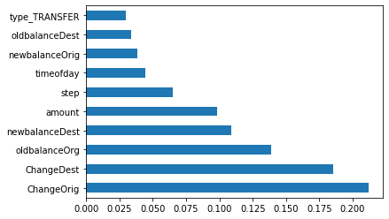
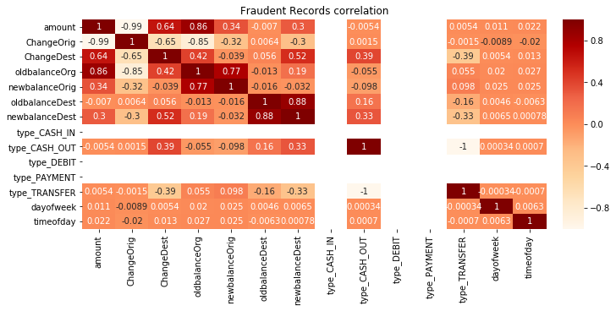
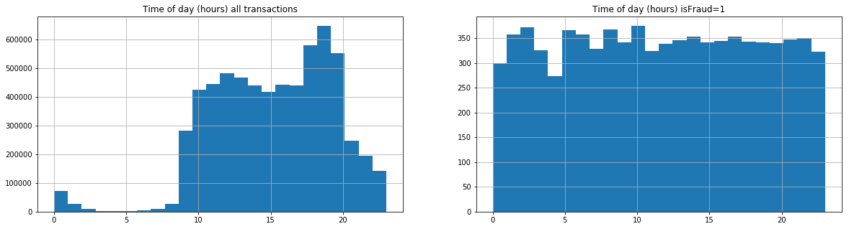
EDA, Feature Selection, Model Pipeline
Categorical field converted to numeric boolean for 5 transaction type values
Drop account name fields with Customer vs Merchant code because no Merchant balances
Feature engineering to create Change Balance and Time of Day features. Visualizations show time pattern, feature importance measure, and correlation matrix
Standard Scaler to normalize data will be added to the model pipeline.
Train, Test, Split partitioning with test_size=0.3 (default is 0.25)
GridSearchCV with default cv=5 will be used for cross validation

Slide 4
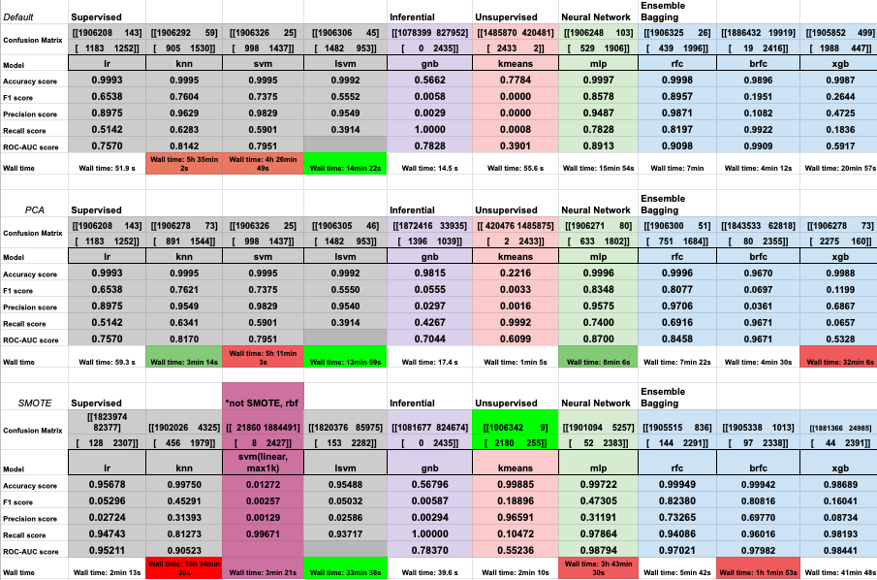
Test Parameters and Results
Supervised, Inferential, Unsupervised, Neural Network, Ensemble Bagging model categories
Metrics of Accuracy, F1, Precision, Recall, and ROC-AUC shown with confusion matrix and run time.
PCA dimensionality reduction and SMOTE balancing techniques are tested, with less than stellar overall results. Some exceptions provide major gains in run time or metrics for certain models. Balancing as a class weight parameter also proved unfruitful.
Run time limits practicality of using some models. Best result is rfc RandomForestClassifier(), and the next step is to maximize parameter tuning on the selected model

Slide 5
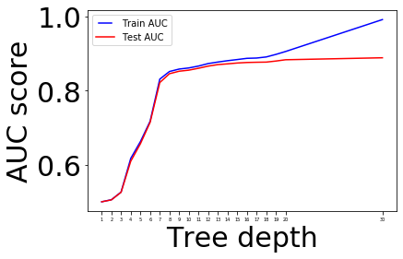
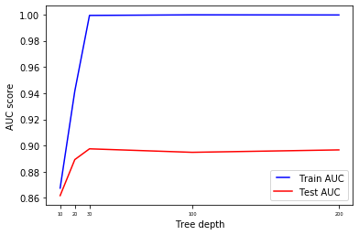
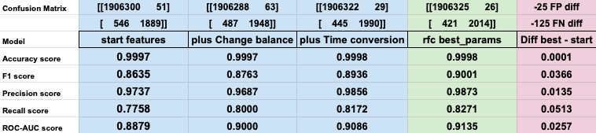
Model Validation, Tuning, Final Result
The incremental gains from adding new feature sets to the data, and tuning the model parameters with Gridsearch Cross Validation are shown in the table, recording an improvement of .05 in the Recall Score, or 125 fewer False Negatives in a test sample of about 1.9M.
The max_depth AUC score is plotted on a limited and expanded scale, to visualize the train vs test score convergence patterns. Although the measured score differential between 20 and 30 is small, the sharp increase in slope to a plateau suggests we can measure the tradeoff for more train accuracy at the risk of overfitting in this range.
In addition to max_depth, the other changes from the default RandomForestClassifier parameters are criterion=’entropy’ over default ‘gini’, and n_esitmators=100 over the default 10 which already throws a future warning message about the switch.

Slide 6
Future Work
Parameter tuning was applied to LR and KNN models with minor gains in metrics. It made sense to review key parameters for overfit/underfit by comparing train vs test results over a range of values. The same could be applied to the remainder of the models, some with a great deal of complexity. In particular, tuning a Neural Network such as MLP and variations of XG Boost have worked out for some Kagglers.
Train, Test, Split test size was held constant, and default parameters were used for SMOTE and PCA. Parameter tuning could be applied to each to ensure optimal selection.
Alternate criteria and ensemble combinations could be interesting to pursue. For example, it might be plausible to focus on minimizing False Negatives by prioritizing Recall at the expense of Precision, or combine models.

